Slide 1
Further Analysis & Recommendations

Slide 2
Factors Influencing Repeat Passenger Rates
• What factors (such as quality of service, competitive pricing, or city demographics) might contribute to higher or lower repeat passenger rates in different cities? Are there correlations with socioeconomic or lifestyle patterns in these cities?
Key Factors
Quality of Service: Higher ratings lead to increased loyalty (e.g., Kochi, Jaipur).
Pricing: Affordable fares attract repeat passengers (e.g., Coimbatore, Lucknow).
City Demographics: Wealthier or professional-heavy cities (e.g., Jaipur) drive frequent usage.
Trip Patterns: Shorter, more frequent trips boost loyalty (e.g., Kochi, Chandigarh).
Tourism vs. Business Impact: Business hubs see more repeat usage; tourist hubs may have temporary users.
Correlation with Trends
Tier-1 vs. Tier-2 Cities: Tier-2 cities show stronger loyalty due to fewer competitors.
Tourism-Driven Cities: Jaipur's tourism reduces repeat passengers, while residential cities like Lucknow increase them.
Observations from Data
High Repeat Rates: Surat (42.63%) and Lucknow likely benefit from affordable fares and quality service.
Low Repeat Rates: Mysore (11.23%) faces challenges due to fewer trip options or competition.

Slide 3
Tourism vs. Business Demand Impact
• How do tourism seasons or local events (festivals, conferences) impact Goodcabs' demand pattems? Would tailoring marketing efforts to these events increase trip volume in tourism-oriented cities?
Tourism-Oriented Cities:
Seasonal demand spikes during festivals/events (e.g., Jaipur Literature Festival).
Inconsistent demand in off-peak seasons.
Tourists prefer longer rides to attractions.
Business-Oriented Cities:
Consistent weekday demand driven by professionals.
Shorter, frequent rides dominate.
Event-driven spikes during conferences.
Tailored Marketing Strategies
Key Insights
Tourism Cities:
Event-based offers during festivals.
Partnerships with hotels/tour agencies.
Geo-targeted ads for tourists.
Business Cities:
Corporate tie-ups for employee subscriptions.
Surge pricing during events.
Pre-booking for meetings/conferences.
Expected Benefits:
Higher Trip Volume: Aligning campaigns with peak seasons.
Improved Loyalty: Positive experiences drive repeat usage.
Revenue Optimization: Maximizing profits during demand surges.

Slide 4
Emerging Mobility Trends and Goodcabs Adaptation
• What emerging mobility trends (such as electric vehicle adoption, green energy use) are impacting the cab service market in tier-2 cities? Should Goodcabs consider integrating electric vehicles or eco-friendly initiatives to stay competitive?
Mobility Trends
EV Adoption: Subsidies, growing infrastructure, and eco-conscious passengers.
Ride-Sharing: Popular among cost-sensitive passengers.
Digital Payments: Integration with UPI/e-wallets supports cashless convenience.
Smart Mobility: IoT and analytics improve operations.
Sustainability Push: Regulations demand greener initiatives.
Why Goodcabs Should Adapt:
Competitive Advantage: Lower costs, customer appeal, and regulatory compliance.
Branding Opportunity: Position as a "green" provider.
Long-term Benefits: Cost savings, government incentives, and operational efficiency.
Actionable Steps for Goodcabs:
Pilot EVs: Start small in cities like Jaipur/Mysore.
Partnerships: Collaborate for charging stations.
Green Branding: Eco-friendly marketing campaigns.
Fleet Optimization: Analytics for route planning and idle time reduction.

Slide 5
Partnership Opportunities with Local Businesses
• Are there opportunities for Goodcabs to partner with local businesses (such as hotels, malls, or event venues) to boost demand and improve customer loyalty? Could these partnerships drive more traffic, especially in tourism- heavy or high-footfall areas?
Key Partnership Areas
Hotels and Resorts: Exclusive transport packages, loyalty programs, and event tie-ups.
Shopping Malls: Discounted rides, promotional campaigns, and designated zones.
Event Venues: Pre-booked rides for concerts, festivals, and corporate events.
Tourism Operators: Guided tours and bundled packages for landmarks.
Transportation Hubs: Airport and railway station connections.
Benefits for Goodcabs
Increased Trip Volume: Regular traffic from high-footfall areas.
Enhanced Customer Loyalty: Convenient and exclusive services.
Revenue Growth: Co-marketing and shared profits.
Brand Credibility: Association with trusted businesses.

Slide 6
Data Collection for Enhanced Data-Driven Decisions
• To make Goodcabs more data-driven and improve its performance across key metrics (such as repeat passenger rate, customer satisfaction, new passengers and trip volume), what additional data should Goodcabs collect? Consider data that could provide deeper insights into customer behavior, operational efficiency, and market trends.
Expected Benefits:
Improved Customer Experience:
Personalized offers, reliable service.
Operational Efficiency:
Optimized fleet management and reduced downtime.
Targeted Marketing:
Event-specific campaigns and high-demand area focus.
Competitive Edge:
Innovative trends (EVs, green energy).
Key Data Areas
Customer Behavior:
Trip frequency, ride preferences, demographics, feedback.
Operational Efficiency:
Driver performance, fleet utilization, ride cancellations.
Market Trends:
Demand patterns, competitor analysis, emerging mobility trends.
Customer Retention:
New passenger sources, loyalty program impact, churn analysis.
Call-to-Action:
Adopt AI-driven analytics and machine learning.
Integrate real-time data from traffic/weather sources.
Maintain data privacy through secure systems.

Slide 7
Business Requests

Slide 8
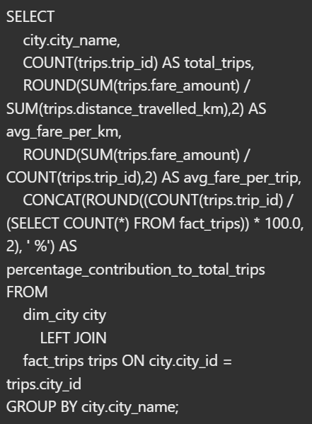
Business Request - 1: City-Level Fare and Trip Summary Report
Generate a report that displays the total trips, average fare per km, average fare per trip, and the percentage contribution of each city's trips to the overall trips. This report will help in assessing trip volume, pricing efficiency, and each city's contribution to the overall trip count.

Slide 9
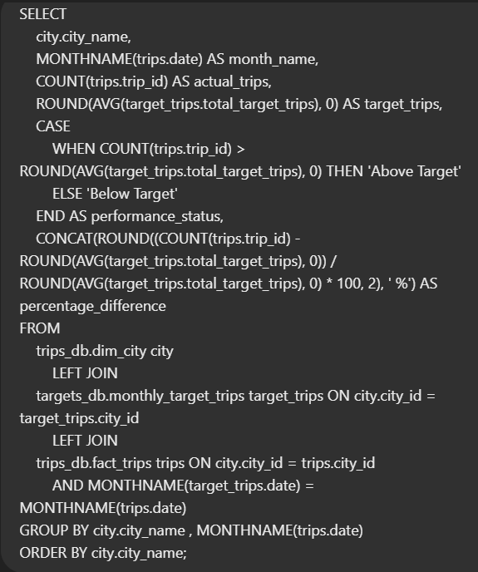
Business Request - 2: Monthly City-Level Trips Target Performance
Report Generate a report that evaluates the target performance for trips at the monthly and city level. For each city and month, compare the actual total trips with the target trips and categorize the performance as follows:
• If actual trips are greater than target trips, mark it as "Above Target".
• If actual trips are less than or equal to target trips, mark it as "Below Target".
Additionally, calculate the % difference between actual and target trips to quantify the performance gap.

Slide 10
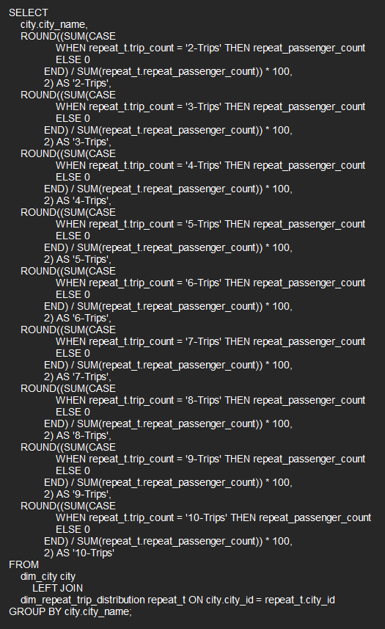
Business Request - 3: City-Level Repeat Passenger Trip Frequency Report
Generate a report that shows the percentage distribution of repeat passengers by the number of trips they have taken in each city. Calculate the percentage of repeat passengers who took 2 trips, 3 trips, and so on, up to 10 trips.
Each column should represent a trip count category, displaying the percentage of repeat passengers who fall into that category out of the total repeat passengers for that city.
This report will help identify cities with high repeat trip frequency, which can indicate strong customer loyalty or frequent usage patterns.

Slide 11
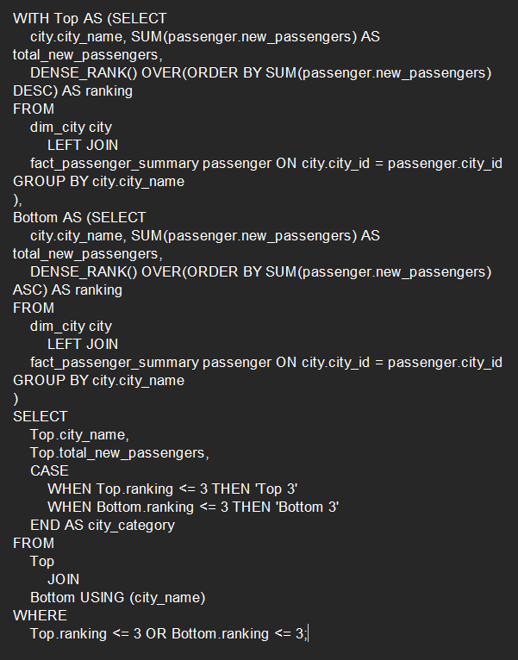
Business Request - 4: Identify Cities with Highest and Lowest Total New Passengers
Generate a report that calculates the total new passengers for each city and ranks them based on this value. Identify the top 3 cities with the highest number of new passengers as well as the bottom 3 cities with the lowest number of new passengers, categorizing them as "Top 3" or "Bottom 3" accordingly.

Slide 12
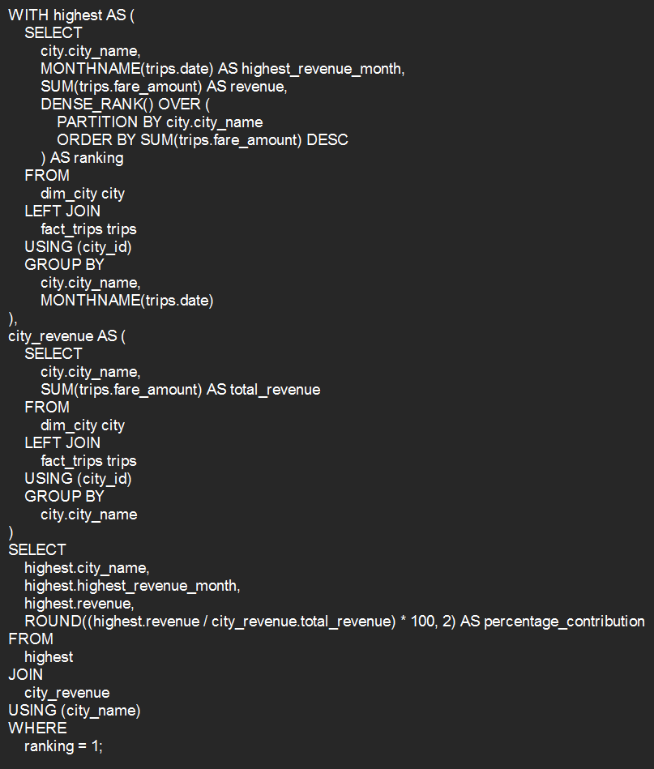
Business Request - 5: Identify Month with Highest Revenue for Each City
Generate a report that identifies the month with the highest revenue for each city. For each city, display the month_name, the revenue amount for that month, and the percentage contribution of that month's revenue to the city's total revenue.

Slide 13
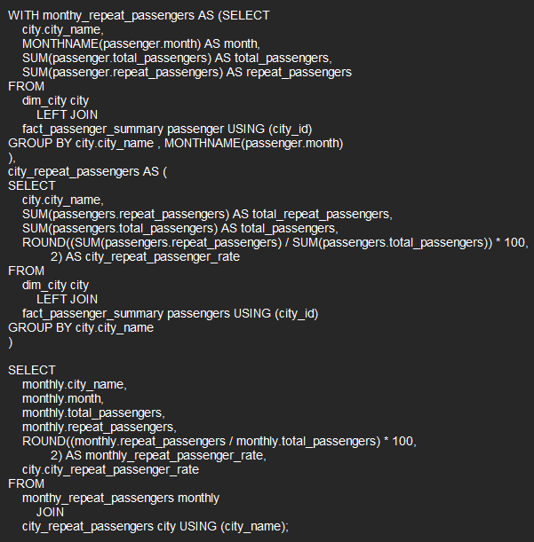
Business Request - 6: Repeat Passenger Rate Analysis
Generate a report that calculates two metrics:
1. Monthly Repeat Passenger Rate: Calculate the repeat passenger rate for each city and month by comparing the number of repeat passengers to the total passengers.
2. City-wide Repeat Passenger Rate: Calculate the overall repeat passenger rate for each city, considering all passengers across months.
These metrics will provide insights into monthly repeat trends as well as the overall repeat behavior for each city.

